Slide 1
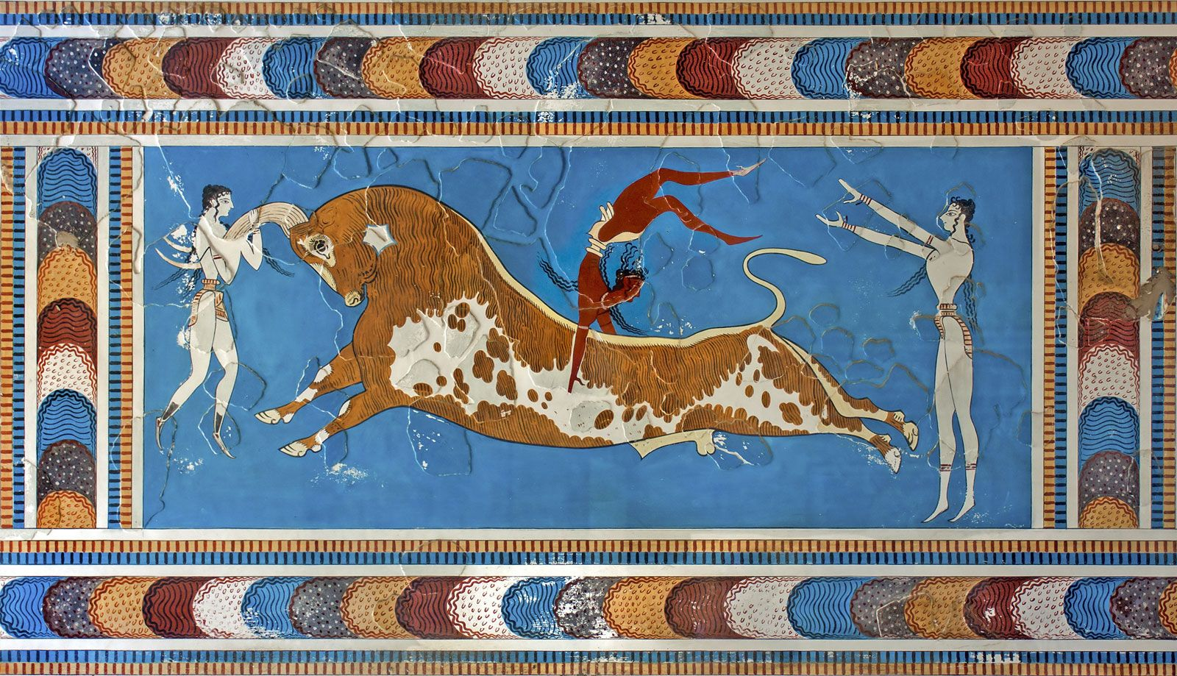
Minoans – Cultural Structures
Goal/s:
Identify and describe the key features of the Minoan cultural structures
Week 3 Lesson 4
Ms Barrie

Slide 2
Today’s Lesson
Cultural structures of minoan society

Slide 3
Cultural Structure
KEY TERM
DEFINITION:
The values, beliefs, behaviour, and material objects that, together, form a people's way of life.
What cultural structures do you already know of?

Slide 4

The art of the Minoans displays a love of animal, sea, and plant life which was used to decorate different things. Minoan art gives valuable insight into the religious, communal, funeral, and daily life practices of the culture.

Slide 5
Cultural Influences
Write the dot-points
Influenced by many other cultures due to International sea trade
Exchange of pottery and foodstuffs (such as oil and wine) in return for precious objects and materials such as copper from Cyprus and ivory from Egypt
Minoan artists were constantly exposed to both new ideas and materials which they could use in their own unique art.
Heavily influenced others

Slide 6
Purpose
Write the dot-points
Functional, decorative AND political purpose
Wall paintings of palaces where rulers were depicted in their religious function: reinforced role as the head of the community
Largely reserved for the ruling elite (small population) compared to the rest of the population (mostly farmers)
Costly art works = means to emphasise differences in social and political status for those fortunate enough to own them

Slide 7
Discussion Question
Flick through your book.
Discuss with the person next to you – what would you expect to see in Minoan art that best represents their culture?
Think about: SYMBOLS, TRADITIONS, RITUALS
2 minutes
CLASS DISCUSSION

Slide 8
ACTIVITY – Source Analysis
Get into 8 groups of four students
Each group will receive a SOURCE SHEET
There will be four rounds – each round will have a different question your group must answer on the sheet

Slide 9
ROUND 1 – 5 minutes
ANSWER ON THE SHEET IN FRONT OF YOU
As a group, Complete BOX 1

Slide 10
ROUND 2 – 5 minutes
SWAP SHEETS WITH ANOTHER GROUP
ANSWER ON THE SHEET IN FRONT OF YOU THAT YOU ARE GIVEN
Read the previous groups’ answers before responding
As a group, Complete BOX 2

Slide 11
ROUND 3 – 5 minutes
SWAP SHEETS WITH ANOTHER GROUP
ANSWER ON THE SHEET IN FRONT OF YOU THAT YOU ARE GIVEN
Read the previous groups’ answers before responding
As a group, Complete BOX 3

Slide 12
ROUND 4 – 5 minutes
SWAP SHEETS WITH ANOTHER GROUP
ANSWER ON THE SHEET IN FRONT OF YOU THAT YOU ARE GIVEN
Read the previous groups’ answers before responding
As a group, Complete BOX 4

Slide 13

FUN FACT – Knossos Palace
According to Greek mythology, the palace was designed by famed architect Daedalus with such complexity that no one placed in it could ever find its exit.
King Minos who commissioned the palace then kept the architect prisoner to ensure that he would not reveal the palace plan to anyone. Daedalus, who was a great inventor, built two sets of wings so he and his son Icarus could fly off the island, and so they did.
On their way out, Daedalus warned his son not to fly too close to the sun because the wax that held the wings together would melt. In a tragic turn of events, during their escape Icarus, young and impulsive as he was, flew higher and higher until the sun rays dismantled his wings and the young boy fell to his death in the Aegean sea. The Labyrinth was the dwelling of the Minotaur in Greek mythology, and many associate the palace of Knossos with the legend of Theseus killing the Minotaur.
Notes:
the Palace at Knossos is an unusual site as it has been impacted by Sir Arthur Evans which means that we may not have a full knowledge on the Minoans.
he was so influential in the excavations and reconstruction of the Palace of Knossos

